Slide 1
JavaScript OOP Prototype

Slide 2
AGENDA
Objects
Object properties
Prototype
OOP
Prototype inheritance

Slide 3


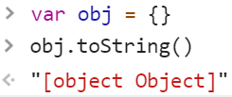


OBJECTS
Collections of key/value pairs, values consist of properties and methods.
Type conversion:
Logical: objects are always true
toString():
valueOf():
Object.keys()
Object.values()
Object.entries()
for … in:
Variable – An enumerable, non-Symbol property name is assigned to variable on each iteration.

Slide 4
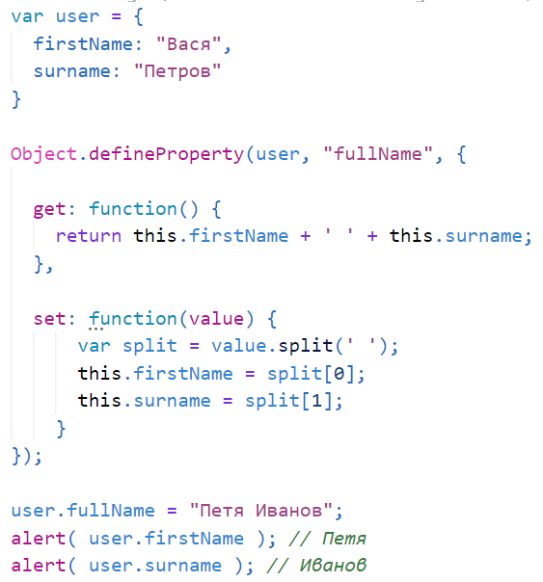
OBJECTS PROPERTIES
DESCRIPTOR
Object.defineProperty(obj, prop, descriptor)
Descriptors:
Value
Writable - true if and only if the value associated with the property may be changed with an assignment operator.
Enumerable – true if and only if this property shows up during enumeration of the properties on the corresponding object.
Configurable – true if and only if the type of this property descriptor may be changed and if the property may be deleted from the corresponding object.
Get/Set – accessor descriptors. Represented as a functions wich get/set property values

Slide 5
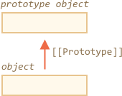
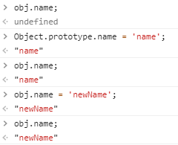

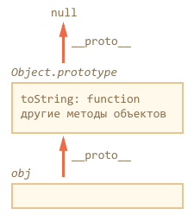

Prototype
Objects have a special hidden property [[Prototype]]
Dynamic connection
Setting property

Slide 6
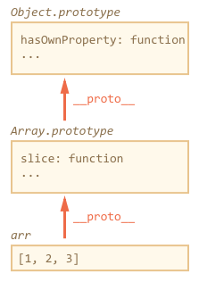
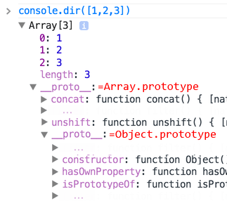


Prototype chain
Prototype chain can be way long
Benefits – using all methods

Slide 7
OOP
The OOP programming style consist of three fundamental features:
Encapsulation - a language mechanism for restricting access to some of the object's components.
Polymorphism - Is the ability to create a variable, a function, or an object that has more than one form.
Inheritance - Is a way to reuse code of existing objects, or to establish a subtype from an existing object, or both, depending upon programming language support.
Pros:
Easy to add features and functionality
Clear structure
Efficient in terms of memory

Slide 8
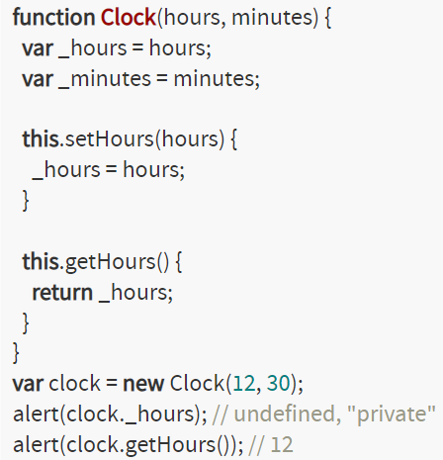
OOP
Encapsulation in JS
Encapsulation is an increasing of abstraction, but not a paranoid hiding from “malicious hackers” which, “want to write something directly into fields of your classes”.
It is a big (and widespread) mistake to use hiding for the sake of hiding. ECMAScript 5, does not define private, protected, and private modifiers how it is in other OOP languages. However, on practice it is possible to see something that is named “imitation of encapsulation in JS”.

Slide 9
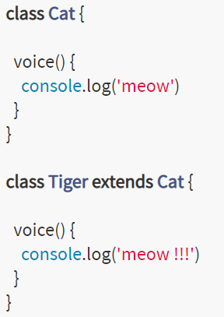
OOP
Polymorphism in JS
Objects in ECMAScript are polymorphic in several meanings.
"polymorphism" describes the idea that a general behavior from a parent class can be overridden in a child class to give it more specifics. In fact, relative polymorphism lets us reference the base behavior from the overridden behavior.

Slide 10

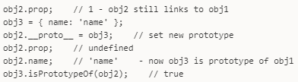

Prototype
Setting prototype
Object.create(obj)
__proto__
new Method()

Slide 11

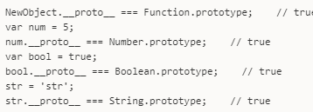

Prototype vs __proto__
The __proto__ is an accessor property of the Object.prototype
__proto__ - link

Slide 12
OOP Patterns
- create class, property, method, constructor
- organize privacy
- add static property or method
- inherit one class from another
- call parent method or constructor
Prototype
Improved prototype
Classical
Functional

Slide 13
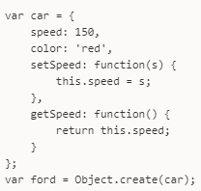
OOP Patterns
Prototype Pattern
- no classes
- the code is placed in the object, car obj = { ... }
- objects are inherited from objects, the prototype chain works
- not used prototype (only prototype connection, __proto__)
- no start initialization
- not suitable for OOP entirely, better for singleton or collections of static functions.

Slide 14
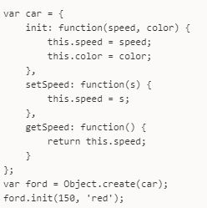
OOP Patterns
Improved prototype
- there is a starting initialization
- there are classes and instances
- class is just an object, but not initialized
- constructor - method with a special name
- use Object.create to create instances, inherit one class from another

Slide 15
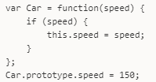
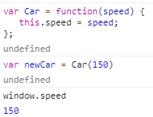
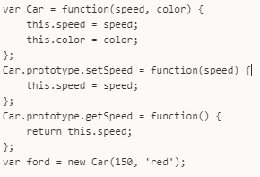
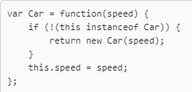
OOP Patterns
Classical
- class - constructor function + its prototype
- initialization with new operator
- methods are placed in prototype
- this is used
DefaultValue
New!

Slide 16

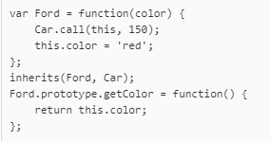
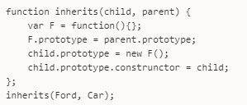

OOP Patterns
Inheritance
Place parent instance in child’s prototype
Why not just parent’s prototype?
Constructor
Call parent’s constructor
Static fields

Slide 17
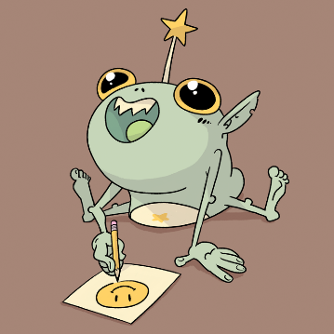


LET’S SUPPOSE WE ARE BUILDING FANTASY WORLD
We have some creatures and heroes:
Hero Black Mage, wizard, human
Creature Pinky, unicorn
Hero Stinky, warrior, goblin
etc.
Functionality:
Drink potion
Cast ultimative ability
Dealing damage
etc.

Slide 18
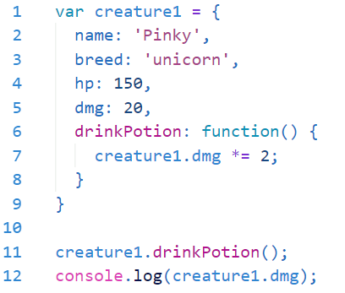
OBJECTS – STORE FUNCTION ASSOCIATED WITH DATA

Slide 19
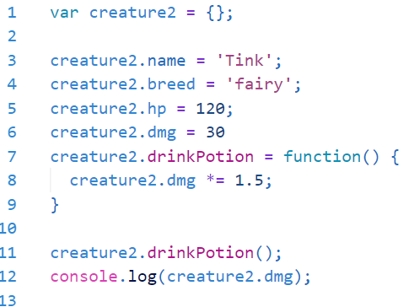
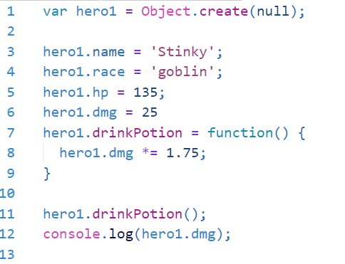
ANOTHER WAYS TO CREATE OUR CREATURES AND HEROES
DOT NOTATION
Object.create()

Slide 20
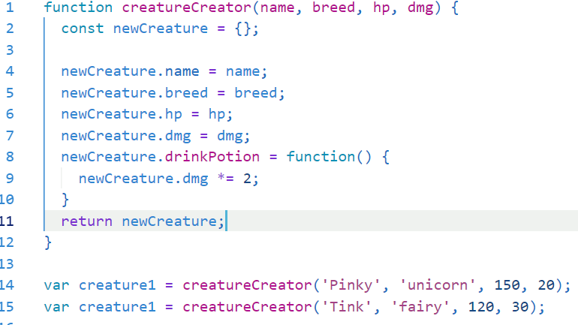
USE FUNCTIONS FOR GENERATING OBJECTS

Slide 21
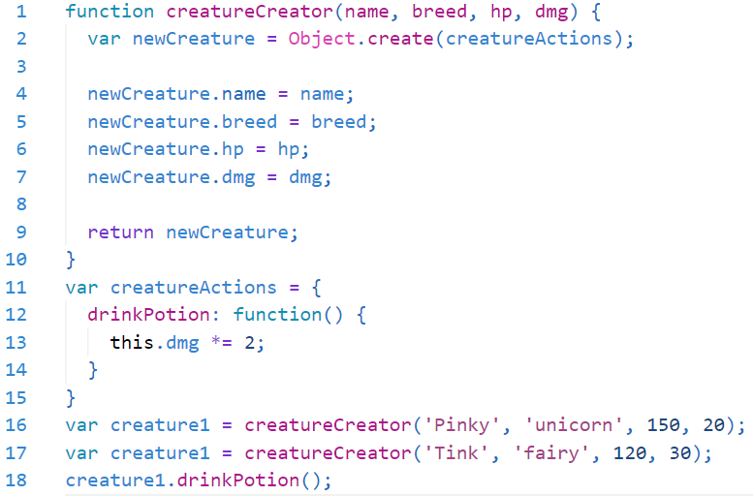
MAKE LINK WITH OBJECT.CREATE()

Slide 22
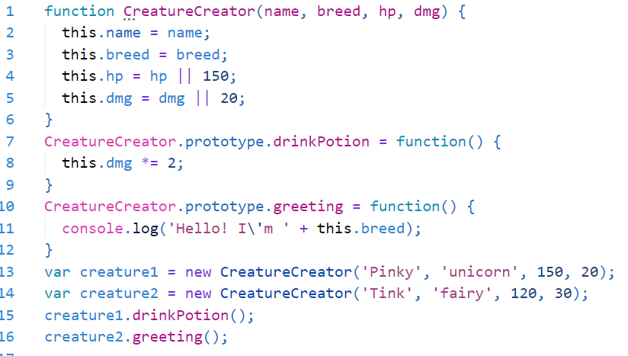
THE KEYWORD NEW

Slide 23
THE KEYWORD NEW
var creature1 = new CreatureCreator('Pinky', 'unicorn', 150, 20);
When we call the constructor function with new in front we automate 2 things:
1. Create a new user object
2. return the new user object
But now we need to adjust how we write the body of CreatureCreator - how can we:
— Refer to the auto-created object?
— Know where to put our single copies of functions?

Slide 24
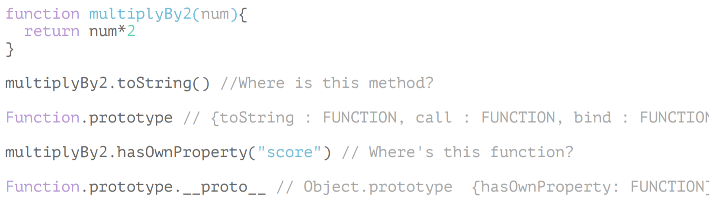
ARRAY AND FUNCTIONS ARE ALSO OBJECTS
Arrays and functions are also objects so they get access to all the functions in Object.prototype but also more goodies

Slide 25
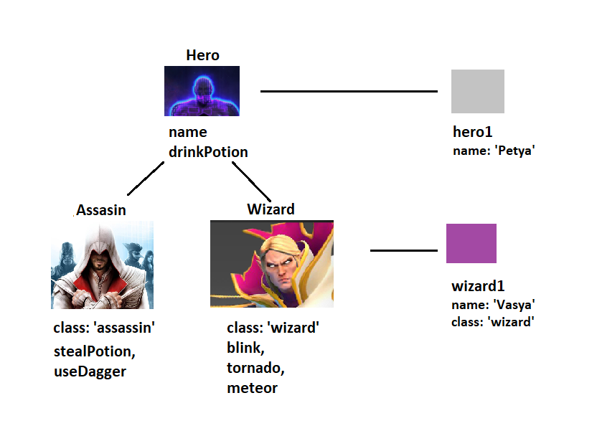
INHERITANCE

Slide 26

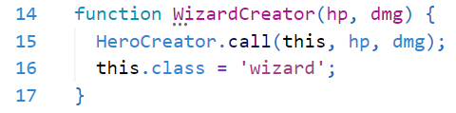

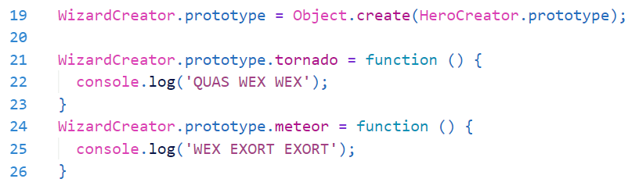
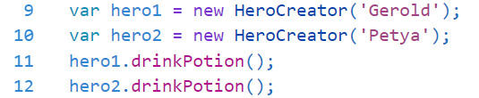

INHERITANCE
Create class
Add functionality to prototype
Now we are able to create heroes
Create subclass
Inherit properties and methods
Add functionality to subclass
Create new wizards

Slide 27
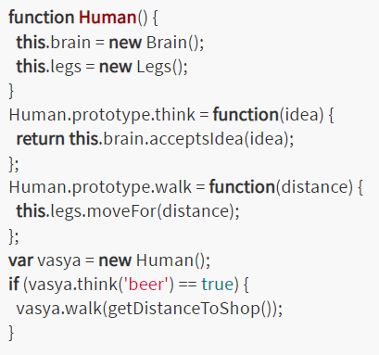
COMPOSITION
Composition is a way to combine simple object to more complex objects.
Think about automobile: it is made of wheels, engine, driver's place, etc.

Slide 28
USEFUL LINKS
https://hackernoon.com/understand-nodejs-javascript-object-inheritance-proto-prototype-class-9bd951700b29
https://frontendlabepam.github.io/FL6/15_intro-to-oop/index.html#1
https://frontendlabepam.github.io/FL6/16_inheritance/index.html#1
https://www.youtube.com/watch?v=GhbhD1HR5vk&list=PL0zVEGEvSaeHBZFy6Q8731rcwk0Gtuxub
https://hackernoon.com/understanding-javascript-prototype-and-inheritance-d55a9a23bde2

Slide 29
THANK YOU!

